Slide 1

Stats 5
Bayesian Statistics
A Whirlwind Tour.

Slide 2
It’s all been wrong!
Bayesian statistics is based on bayes theorem. Invented by the reverend Thomas bayes in the 1700s.
It then took about 300 years before it started taking off.
And now everyone claims it’s the only way to do statistics and we’ve all been wrong.

Slide 3
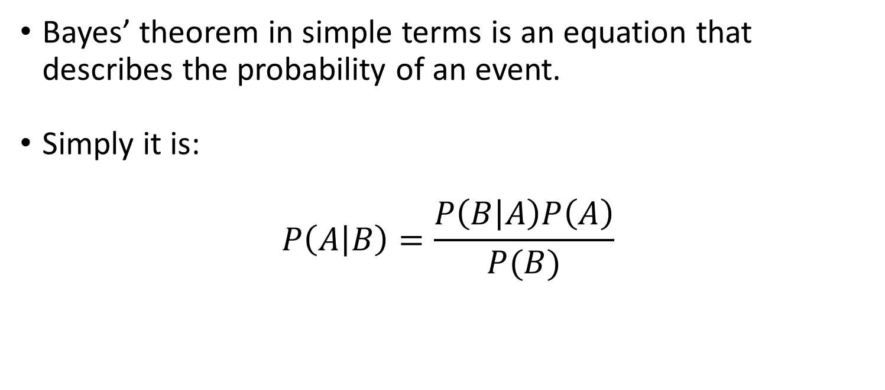
Bayes’ theorem
Bayes’ theorem in simple terms is an equation that describes the probability of an event.
Simply it is:
$$P\left(A | B\right)=\frac{P\left(B | A\right)P\left(A\right)}{P(B)}$$

Slide 4
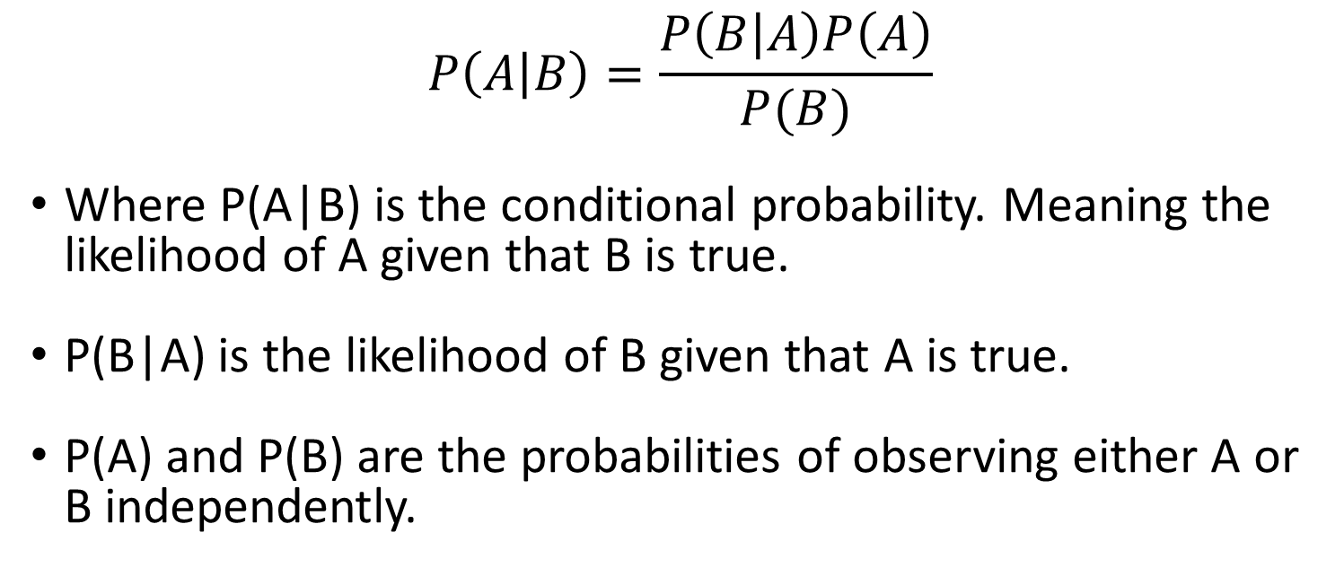
Bayes’ theorem
$$P\left(A | B\right)=\frac{P\left(B | A\right)P\left(A\right)}{P(B)}$$
Where P(A|B) is the conditional probability. Meaning the likelihood of A given that B is true.
P(B|A) is the likelihood of B given that A is true.
P(A) and P(B) are the probabilities of observing either A or B independently.

Slide 5
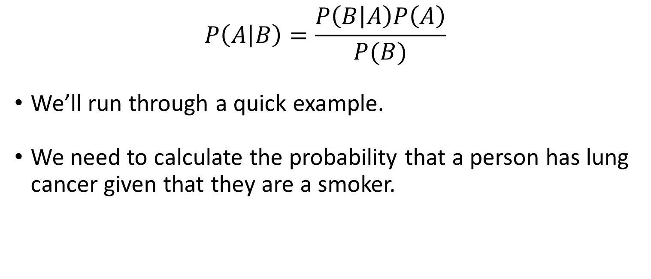
Bayes’ theorem
$$P\left(A | B\right)=\frac{P\left(B | A\right)P\left(A\right)}{P(B)}$$
We’ll run through a quick example.
We need to calculate the probability that a person has lung cancer given that they are a smoker.

Slide 6
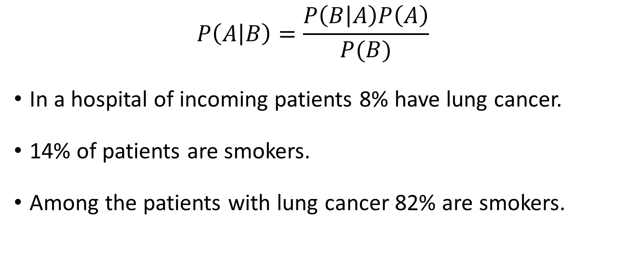
Bayes’ theorem
$$P\left(A | B\right)=\frac{P\left(B | A\right)P\left(A\right)}{P(B)}$$
In a hospital of incoming patients 8% have lung cancer.
14% of patients are smokers.
Among the patients with lung cancer 82% are smokers.

Slide 7
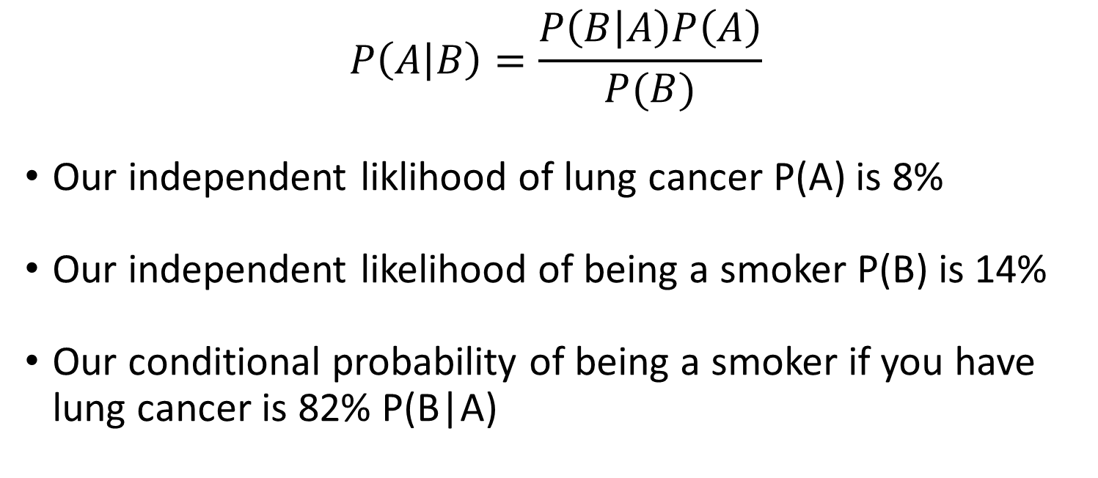
Bayes’ theorem
$$P\left(A | B\right)=\frac{P\left(B | A\right)P\left(A\right)}{P(B)}$$
Our independent liklihood of lung cancer P(A) is 8%
Our independent likelihood of being a smoker P(B) is 14%
Our conditional probability of being a smoker if you have lung cancer is 82% P(B|A)

Slide 8

Bayes’ theorem
$$P\left(A | B\right)=\frac{0.82 × 0.08}{0.14}$$
Plugging it in our chance of developing lung cancer if you are a smoker is.

Slide 9
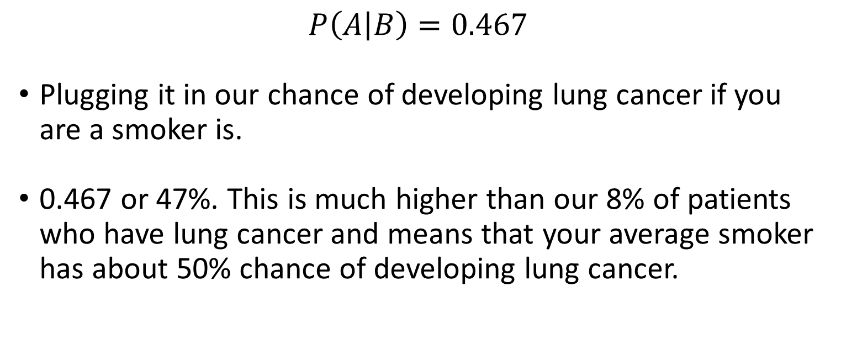
Bayes’ theorem
$$P\left(A | B\right)=0.467$$
Plugging it in our chance of developing lung cancer if you are a smoker is.
0.467 or 47%. This is much higher than our 8% of patients who have lung cancer and means that your average smoker has about 50% chance of developing lung cancer.

Slide 10
Bayesian Statistics
Bayes’ theorem is the fundamental basis of Bayesian statistics.
Bayesian statistics are based on the degree of belief in an event generally whether our hypothesis is true, but the critical thing is this belief can be updated as new information is added.

Slide 11
Bayesian Statistics
One of the things we have to understand is the difference between probability and likelihood.
Many of the models we have dealt with have calculated the likelihood of your model.
This likelihood is based on your hypothesis. It is the likelihood that your hypothesis is true given your data.

Slide 12
Bayesian Statistics
Probability on the other hand is just the probability of your observed results given your data with no attachment on your hypothesis.
The different probability of all the different possible outcomes is used to build a probability distribution which can then be compared between things.

Slide 13
Bayesian Statistics
An example:
Flipping a coin 10 times. Then get people to predict the outcomes.
Each person can only have one of 11 options : 0 – 10 correct predictions.

Slide 14
Bayesian Statistics
An example:
The first person gets 7 out of 10 correct.
Why might this be?
Maybe the person is psychic?
Maybe just luck?

Slide 15
Bayesian Statistics
Maybe the person is psychic?
Maybe just luck?
These are hypotheses, they don’t cover every possible option just ones we think. These rely on likelihood.

Slide 16
Bayesian Statistics
Likelihood of each of our hypothesis doesn’t tell us much independently can only be compared to each other.
Vs probability tells us something far more specific. The actual probability of each event.
The problem is probability requires knowing something about the probabilities involved in our data. i.e a coin should be 50/50.

Slide 17
Bayesian Statistics
With likelihood you have the result of 7 correct. The number of trials 10 and it tries out lots of different probabilities and creates a likelihood function of our observed outcome based on that.
It then matches that likelihood to your hypotheses. By comparing between them.

Slide 18
Bayesian Statistics
If we understand the probabilities of each result based on coins being 50/50 and look at the probability distribution we can see that 7/10 is not that far from 5 and disregard that it is special.
This is Bayesian statistics in it’s simplest form.

Slide 19
Bayesian Statistics
If we think about our two previous concepts, in both we worked out a probability of an event, given the data we had and some underlying assumption.
The other important thing is that you can update your probabilities based on new data.

Slide 20
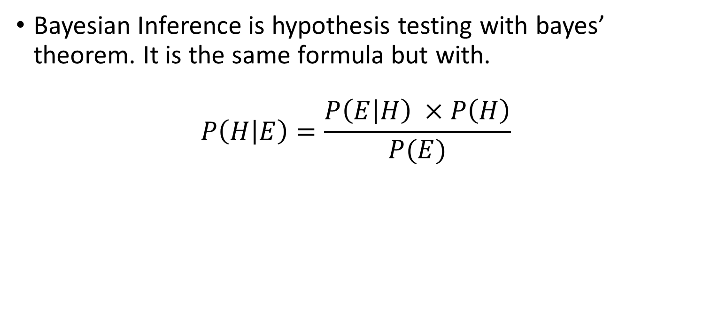
Bayesian Inference
Bayesian Inference is hypothesis testing with bayes’ theorem. It is the same formula but with.
$$P\left(H | E\right)=\frac{P\left(E | H\right) ×P\left(H\right)}{P(E)}$$

Slide 21
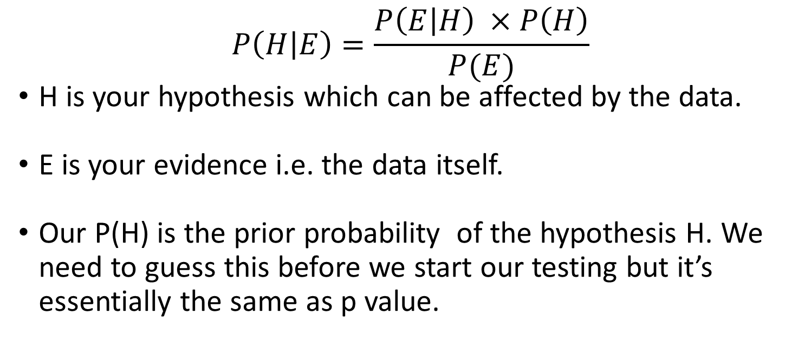
Bayesian Inference
$$P\left(H | E\right)=\frac{P\left(E | H\right) ×P\left(H\right)}{P(E)}$$
H is your hypothesis which can be affected by the data.
E is your evidence i.e. the data itself.
Our P(H) is the prior probability of the hypothesis H. We need to guess this before we start our testing but it’s essentially the same as p value.

Slide 22
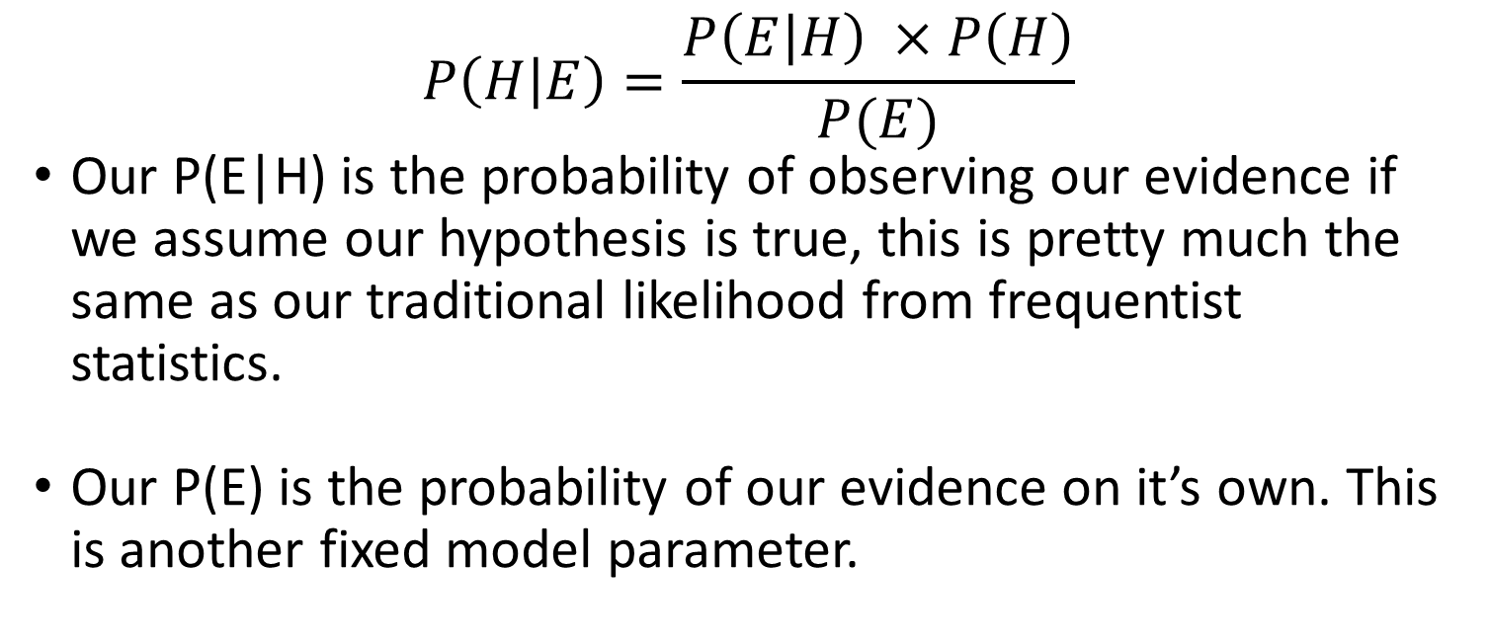
Bayesian Inference
$$P\left(H | E\right)=\frac{P\left(E | H\right) ×P\left(H\right)}{P(E)}$$
Our P(E|H) is the probability of observing our evidence if we assume our hypothesis is true, this is pretty much the same as our traditional likelihood from frequentist statistics.
Our P(E) is the probability of our evidence on it’s own. This is another fixed model parameter.

Slide 23
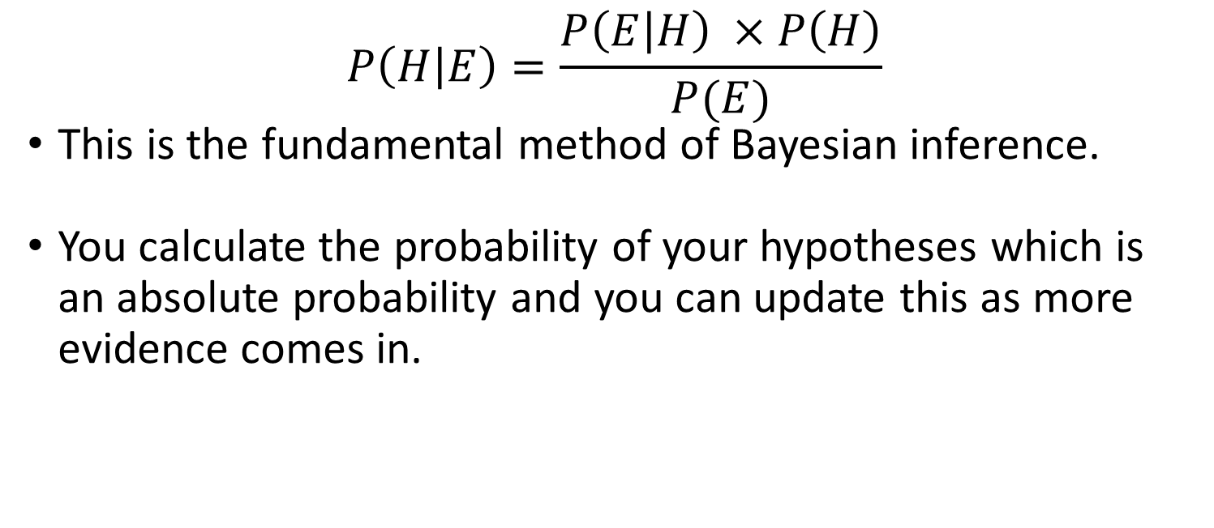
Bayesian Inference
$$P\left(H | E\right)=\frac{P\left(E | H\right) ×P\left(H\right)}{P(E)}$$
This is the fundamental method of Bayesian inference.
You calculate the probability of your hypotheses which is an absolute probability and you can update this as more evidence comes in.

Slide 24
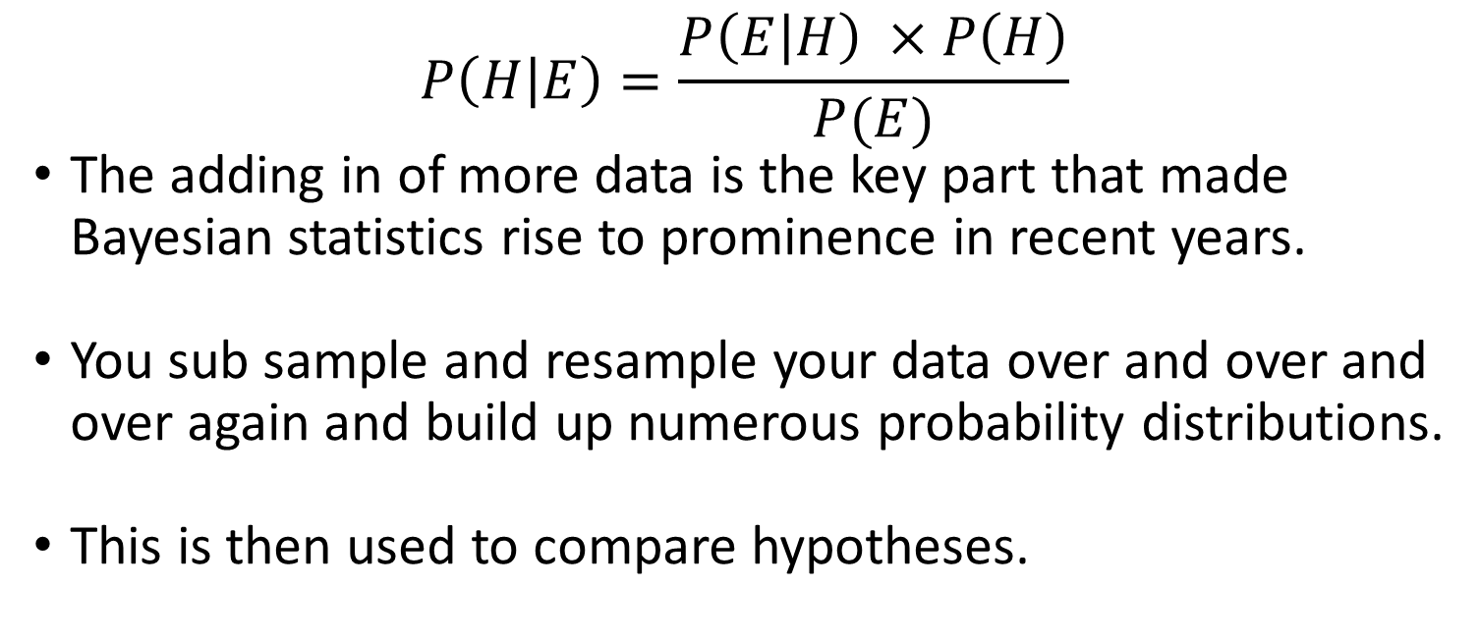
Bayesian Inference
$$P\left(H | E\right)=\frac{P\left(E | H\right) ×P\left(H\right)}{P(E)}$$
The adding in of more data is the key part that made Bayesian statistics rise to prominence in recent years.
You sub sample and resample your data over and over and over again and build up numerous probability distributions.
This is then used to compare hypotheses.

